Slide 1
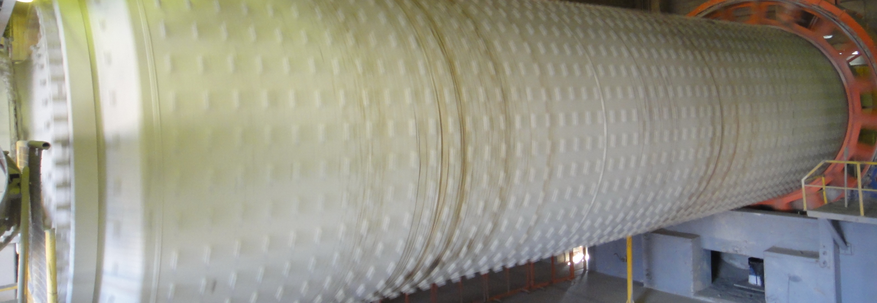
Ball Mill Optimisation - Solution
Process and Progress of Grinding

Slide 2
Task 1: Mill Calculation
What is the maximum filling degree of CM4 without modification of the mill internals?
What is the absorbable power of the mill when topping up the maximum ball charge?
What is the expected production rate of CM4 with maximum ball charge?

Slide 3
Mill Calculation Sheet

Slide 4
Mill Calculation Sheet – maximum ball charge

Slide 5
Task 1: Mill Calculation
What is the maximum filling degree of CM4 without modification of the mill internals? 29.5 and 29.3 %
What is the absorbable power of the mill when topping up the maximum ball charge? 4’650 kW at counter
What is the expected production rate of CM4 with maximum ball charge? 175 t/h at same specific grindability of 26.5 kWh/t

Slide 6
Ball charge – as reported from the last new charging

Slide 7
Longitudinal sieving result CM4 - Table

Slide 8
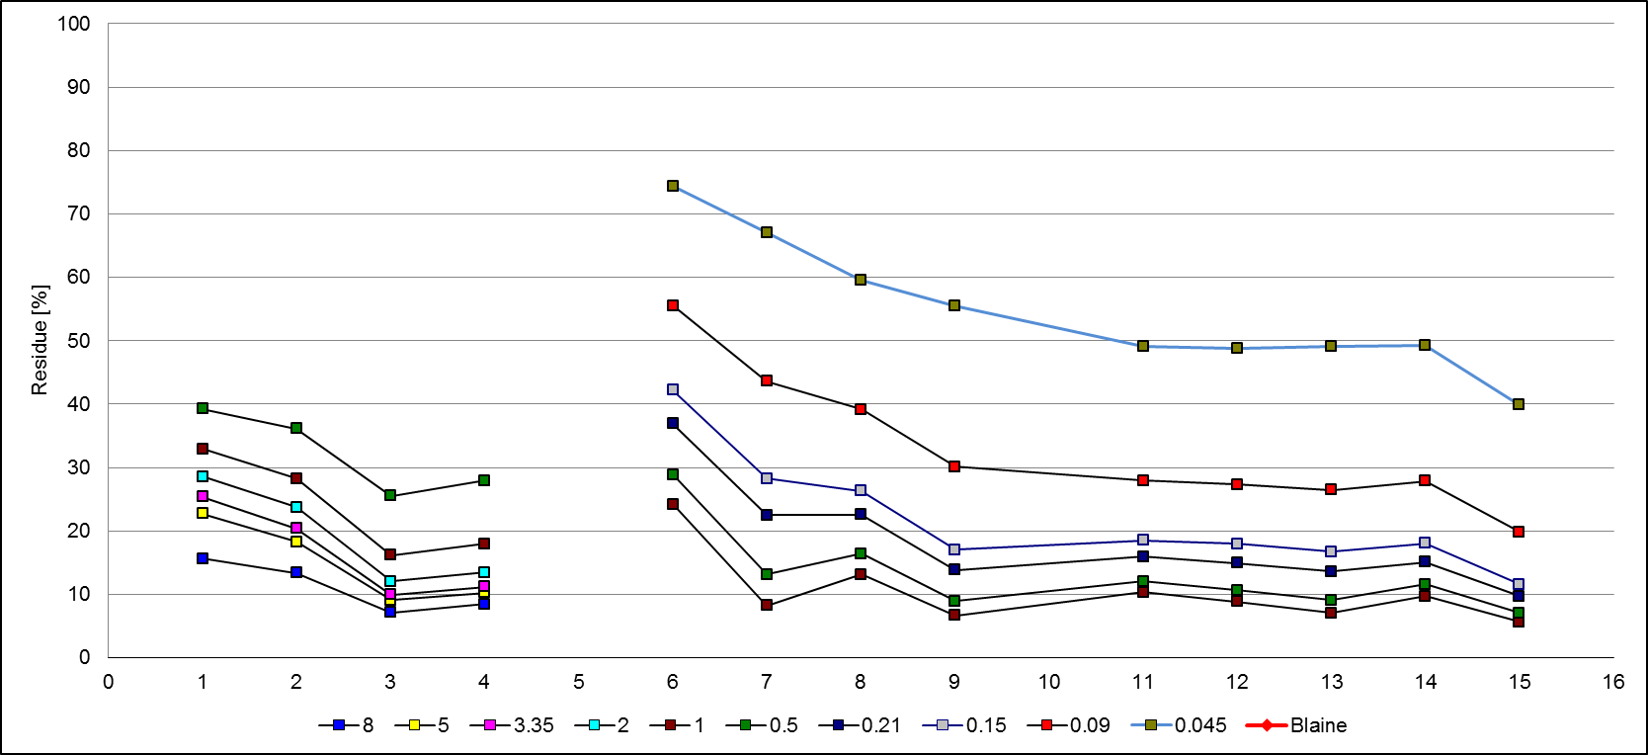
Longitudinal sieving result CM4

Slide 9
Task 2: Longitudinal Sieving
What is your opinion about the sieving results?
First chamber? Second chamber?
Which other information is required to make statements?
How could the ball charge be changed?
Chamber 1
Chamber 2

Slide 10
Longitudinal sieving result CM4
No grinding progress

Slide 11
Comments: Longitudinal Sieving
Basically good grinding progress
Slight increase of the residues in front of the diaphragm is normal.
Insufficient grinding in the first chamber
12 – 14 % R 2 mm instead of 5 % R 2 mm
No further grinding progress in second chamber from 11 m to mill discharge
At current condition fine grinding doesn’t work properly

Slide 12
Actions: Longitudinal Sieving
Check mill parameters like feed PSD, circulating load, separator performance and mill control for plausibility
Check material level in both chambers
If first chamber is empty reduce permeability of the diaphragm
After confirmation of the sieving results make the ball charge finer by topping up the second chamber with 17, 20 and 25 mm balls
Repeat the longitudinal sieving for the next loop

